Slide 1
Music Genre Classification using Deep Learning
TEAM D
Koushik Mannaru (XV15653)
Sravani Pilla (RQ88772)
Sreeja Komma Reddy (OD00859)

Slide 2
Project Objective
Utilize deep learning techniques to achieve accurate music genre classification based on audio features, elevating the capabilities of music recommendation systems.
Impact: This will not only refine the user experience on streaming services but also contribute to our understanding of how technology can capture the essence of music genres.
End Goal: Through sophisticated algorithms, we aspire to create a nuanced music discovery experience, bringing users closer to the melodies that resonate with them.

Slide 3
Literature Review And Industry Research
Evolution of Music Genre Classification Techniques
Traditional Machine Learning Methods:
Historical Basis: Pioneered by Tzanetakis and Cook, focusing on timbre, pitch, and rhythm using standard classifiers.
Highlighted the potential but remained limited by non-complex feature utilization. [Ref 1]
Limitations: These early models often failed to capture the deeper, more intricate patterns in audio data that are crucial for a
refined classification.
Transition to Advanced Models:
Introduction of CNNs: More recent studies have employed CNNs, which automatically extract deeper features from audio
signals, presenting a significant shift from manual feature crafting. [Ref 2]
Issue of Temporal Dynamics: While CNNs improved feature extraction, they lacked effective handling of time-based data
sequences, critical for capturing musical progression.
Our Hybrid CNN-LSTM Approach:
Integration and Innovation: Combines CNNs for robust feature extraction with LSTMs to model temporal sequences, filling
the gap left by previous models.
Resulting Advantages: This hybrid model effectively captures both spatial and temporal audio data, leading to more accurate
genre classification.

Slide 4
Comparative Performance and Future Directions
Performance Enhancement:
Empirical Results: Our model demonstrates a substantial improvement over traditional methods, achieving training accuracy of approximately 65% and testing accuracy of 53%. These figures notably exceed the accuracies reported in prior studies. [Ref 3, Ref 4]
Contextual Superiority: The integration of CNNs and LSTMs leverages the strengths of both architectures, providing a comprehensive understanding of complex audio signals.
Conclusion and Future Directions
Inference and Future Work: The application of deep learning to music genre classification not only enhances the accuracy of models but also opens avenues for more nuanced understanding and discovery of musical genres. Future work will focus on expanding the dataset and incorporating real-time classification to support dynamic streaming services.
Overall Contribution: By integrating advanced deep learning architectures, our project moves beyond the limitations of traditional methods and sets a new benchmark in the field of music genre classification. This advancement contributes significantly to both academic research and practical applications in music streaming platforms.

Slide 5
Dataset Introduction
Dataset: Utilized the GTZAN dataset, a renowned collection for music genre classification, available on Kaggle.​
​
Link: https://www.kaggle.com/datasets/andradaolteanu/gtzan-dataset-music-genre-classification/data​
​
Specifications: The dataset comprises 1,000 audio tracks each 30 seconds long, evenly distributed across 10 genres, totaling 100 tracks per genre. It includes a variety of features such as tempo, beats, and melodic rhythms.​
​

Slide 6
Music Genre Classification Approach
Data Overview:
Dataset Used: GTZAN dataset, a renowned resource in music genre classification.
Composition: Comprises 1,000 audio tracks, each 30 seconds long, spread evenly across 10 genres.
Additional Dataset: Developed a test dataset of 100 songs from free music archives to enhance model evaluation.
Data Preparation:
Split: Data is strategically divided into training (75%) and testing (25%) sets.
Feature Extraction: Utilized Librosa and pydub libraries to process audio and extract features like MFCCs.
Technological Methodology:
CNN: Employs Convolutional Neural Networks to extract complex feature maps from audio files,which capture essential textural and structural details.
LSTM: Subsequently, the LSTM network analyzes these features to identify and learn patterns over time, enhancing the model's ability to predict music genres with higher accuracy.

Slide 7
Model Implementation And Workflow
Model Architecture:
Hybrid Approach: Combines CNN for initial feature extraction and LSTM to analyze these features over time.
Goal: To leverage the strengths of both architectures for a robust understanding and classification of music genres.
Workflow Overview:
Data Collection: Gather raw audio tracks for systematic analysis.
Feature Engineering: Identification of key attributes, such as Mel-frequency cepstral coefficients (MFCCs), crucial for genre classification.
Visualization: Employ Mel spectrograms for a visual representation of frequency variations.
Testing and Validation:
Model Training: Uses the features extracted to train the deep learning model on distinguishing genres.
Prediction and Identification: Classifies unseen music tracks from the new dataset by genre and verifies model predictions against known labels.

Slide 8
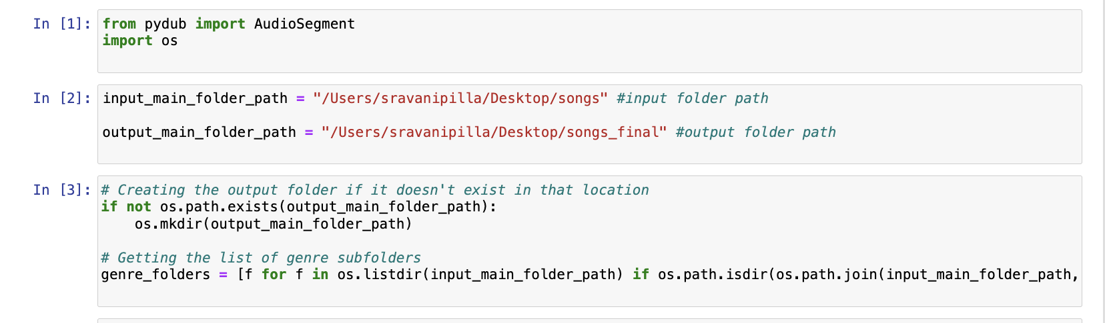
Test Dataset Preparation For Robust Validation
Developed a music dataset that mirrors the GTZAN music genre classification dataset for accurate model evaluation.
Sourced 100 songs from free music archives on the Internet, ensuring a diverse representation by selecting 10 songs for each of the 10 genres.
Stored all the songs in separate genre folders for organized processing.
Utilized the Python library Librosa and pydub to handle audio file manipulations.

Slide 9
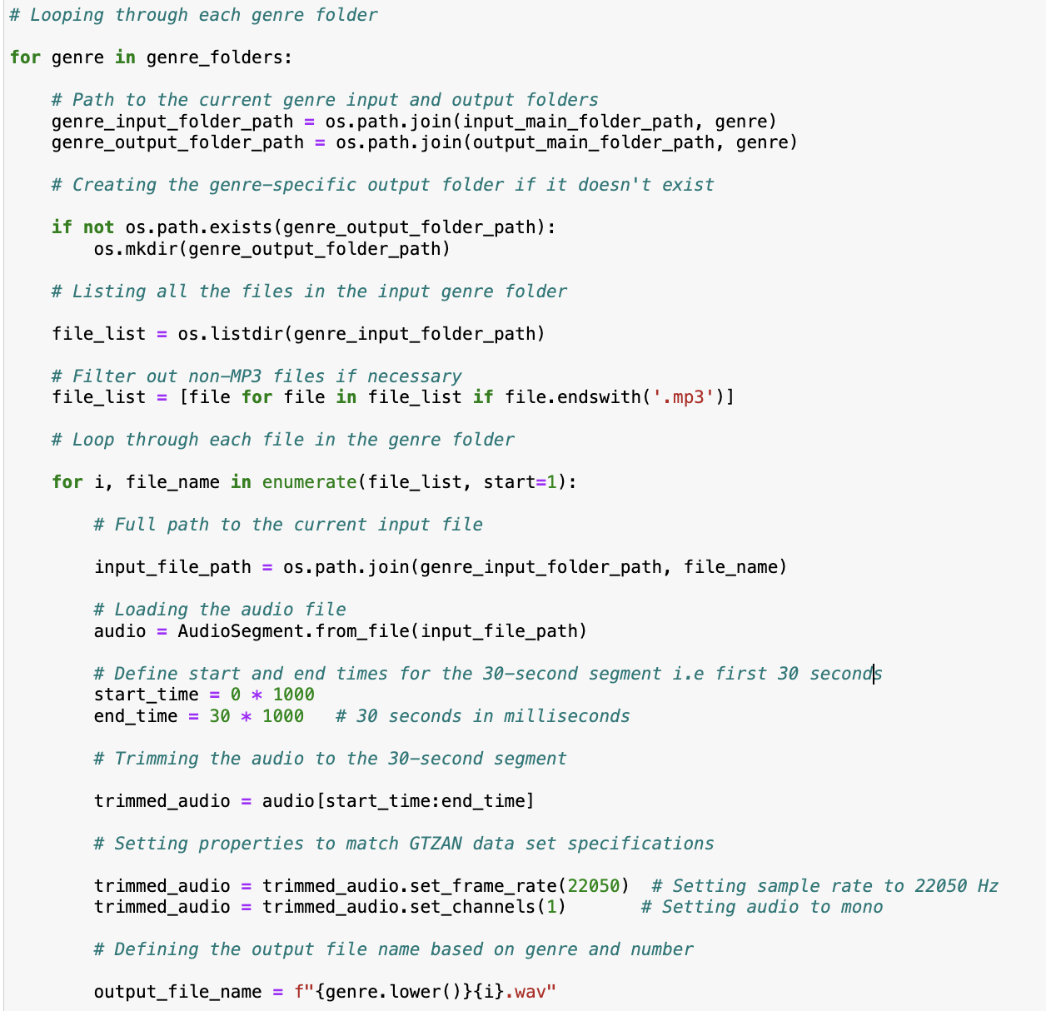
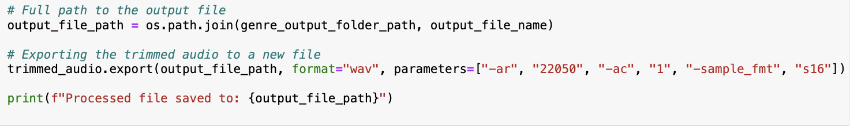
All the song files in separate folders are read and processed to extract a consistent 30-second audio segment from each song, mirroring GTZAN’s format.
Audio properties are adjusted to match GTZAN specifications (sample rate and channel settings).
Sample Rate: Set to 22050 Hz.
Channels: Converted to mono (1 channel).
Sample format: 16-bit.

Slide 10
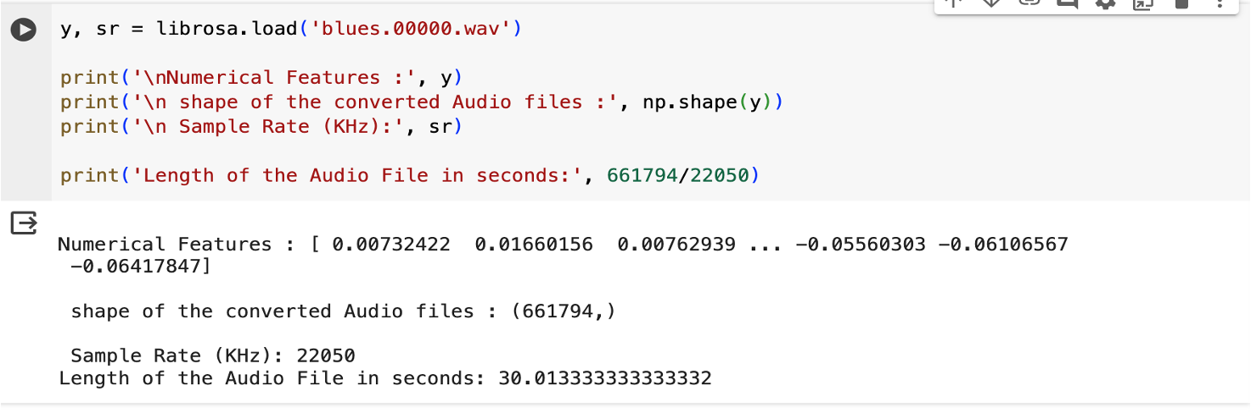
Exploratory Data Analysis - Overview
Before diving into model training, dataset is explored to understand the characteristics and patterns within the music files.
Librosa library, a powerful tool in Python was used for analyzing and extracting features from music and audio signals.It is also widely used in fields like music information retrieval sound classification and signal processing.
Insights Gained: By visually inspecting the audio, patterns in waveforms and spectrograms that could correlate with genre-specific traits were discovered.

Slide 11
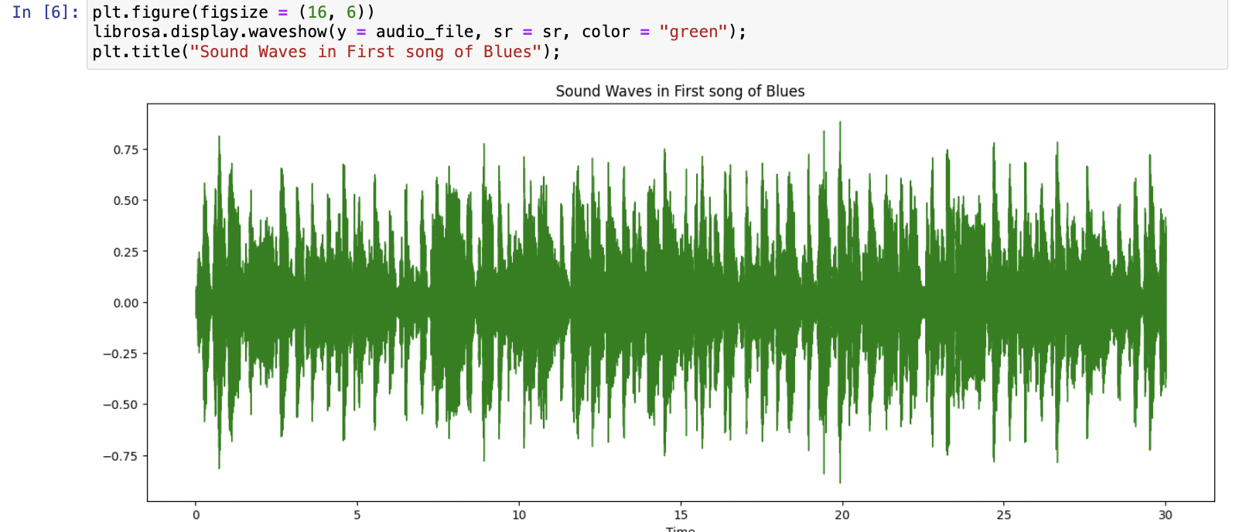
Exploratory Data Analysis - Visualizing Sound
Sound waves are plotted to analyze the amplitude variations over time, which gives insight into the loudness and energy of the tracks.

Slide 12
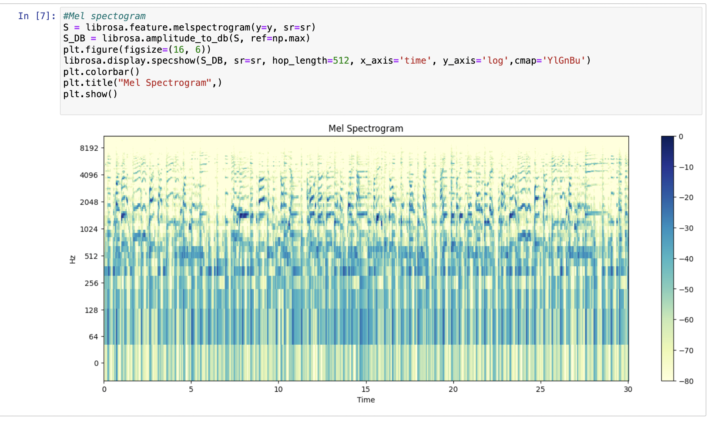
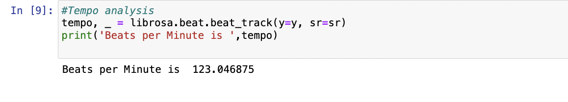
Spectrogram Analysis: Using Mel Spectrograms, sound is translated into a visual landscape, revealing how frequencies vary with time which is an essential feature for genre classification.
Tempo and the speed of track are examined which along with rhythmic patterns helps in distinguishing between genres.

Slide 13
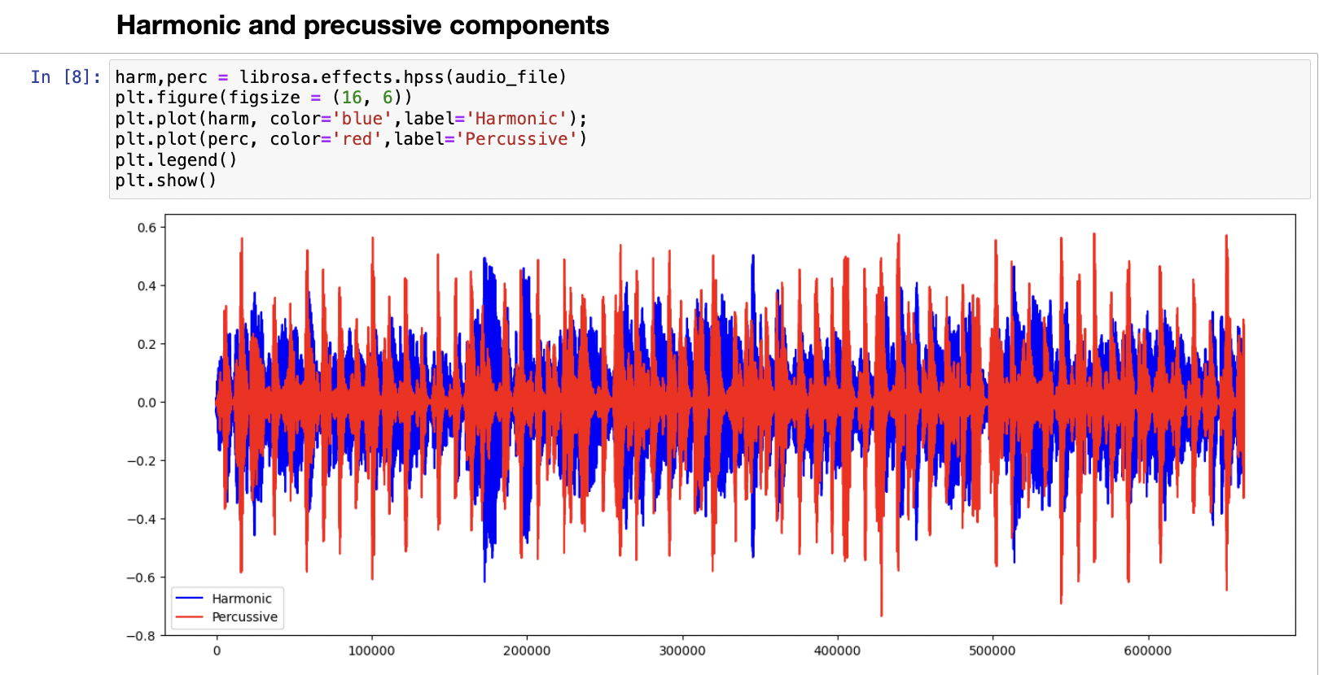
Exploratory Data Analysis - Beyond the Ear
Harmonics vs. Percussive Elements: Our analysis separates harmonics from percussive sounds, which are often challenging to differentiate by ear, yet critical for understanding the music's texture.

Slide 14
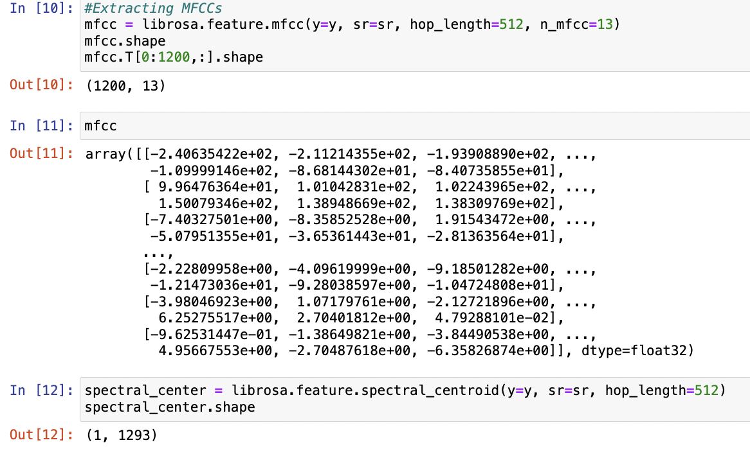
Feature Engineering
Advanced Features: Advanced audio features such as Mel-frequency cepstral coefficients (MFCCs) were extracted that encapsulate key aspects of sound used to train our genre classification models.These coefficients provide a representation of the audio based on human auditory perception and are commonly used in voice recognition and music genre classification systems.

Slide 15
Model Architecture
After Preprocessing the Audio files and extracting numerical features, the data is then sent to a model with 2 Layers of Convolution Neural Net and then 2 Layers of Long Short Term Memory
To reduce overfitting, the drop out ratio of the neural net is set to 0.5
Later, A Softmax Layer is used in the last layer to find the probabilities of the different categories of the audio file
Since the Data has 100 songs in each category which makes it 1000 songs, we used Accuracy as the metric to measure this balanced classification problem
To assess the Performance of the model, we used k fold cross validation with 5 folds and we observed an Accuracy of around 60% for each fold

Slide 16
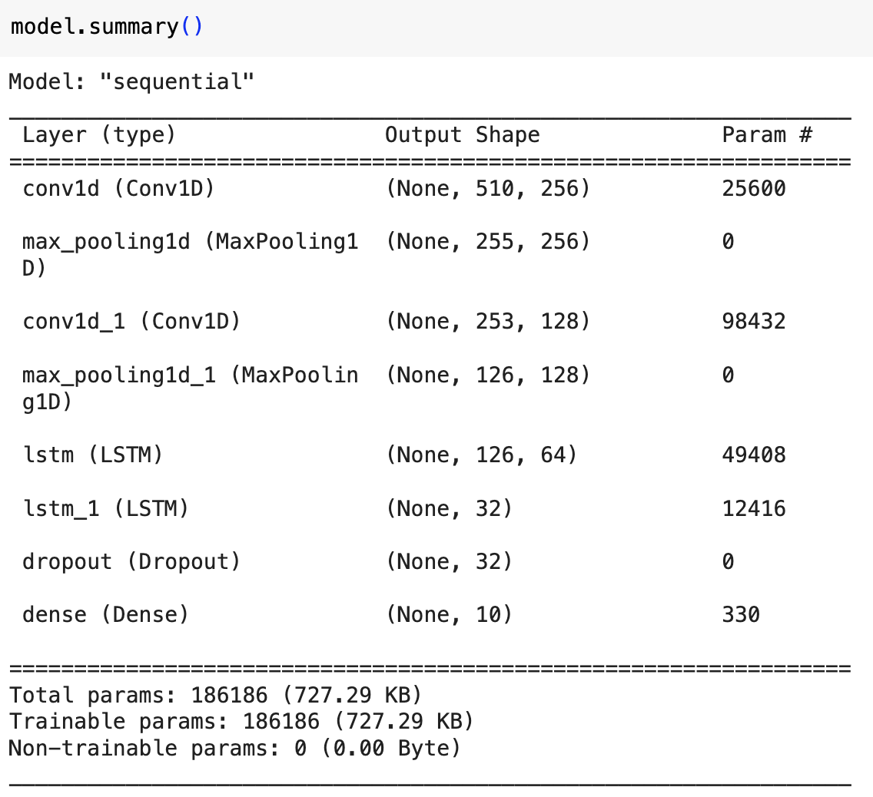
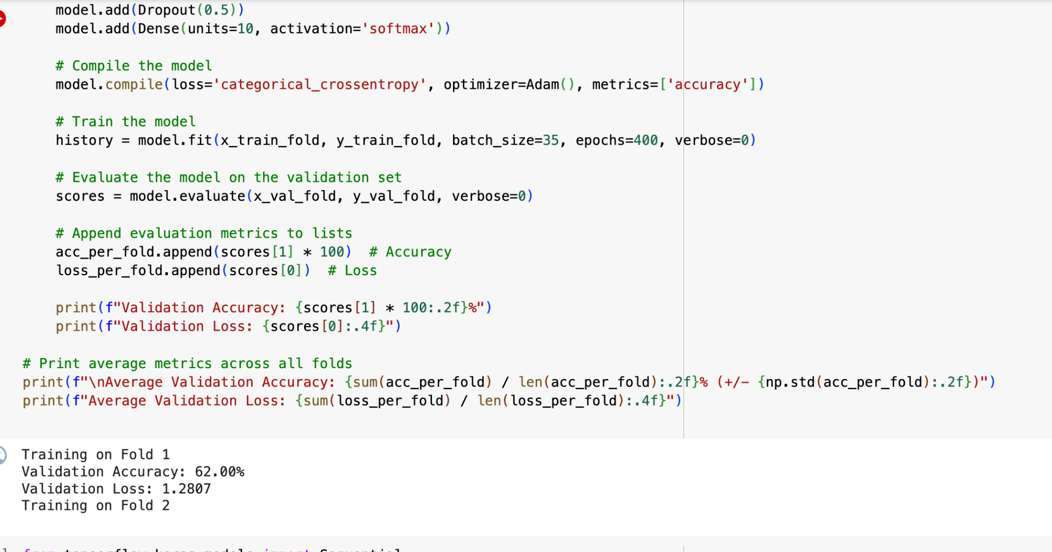

Slide 17
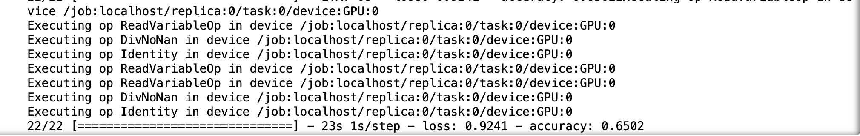
Training and Testing Accuracies
The whole Dataset is split into 75:25 ratio with 75% being Training data and 25% being Test data
The data is divided into batches with batch size of 35 and run into 400 epochs to train the model
We observed a Training Accuracy of around 65% and Testing Accuracy of around 53%

Slide 18

Model Performance on New Test Dataset on Unseen Songs
We have collected 10 latest songs per category from internet archives and we converted this data according to our Model Architecture. The resultant data is 16 bit, with Sample Frequency of 22050 Hz and Mono channel
After Extracting Numerical features from this audio files, these are passed to the model to perform classification task
We observed an Accuracy of around 31% for this data set

Slide 19
Challenges
Encountered corrupted audio files within the dataset.These files were identified and removed during the data preparation phase to ensure data integrity.
Hyperparameter tuning required extensive computational resources for running 400 epochs;To manage the computational load, the task was distributed across multiple systems. Multiple models were built and evaluated, allowing the selection of the most effective model based on performance.
Ensuring new songs meet the 30-second audio requirement for consistent analysis; Each newly collected song was manually checked to confirm it contained a complete 30-second audio segment. Only the first 30 seconds of these tracks were then extracted for consistency in dataset preparation.

Slide 20
Summary
Successfully applied deep learning to achieve up to 65% training and 53% testing accuracy in music genre classification
Utilized a hybrid architecture combining CNNs for feature extraction and LSTMs for pattern recognition, advancing audio data classification techniques.
Enhanced model validation with a diverse test dataset sourced from free music archives on internet, showing a preliminary accuracy of 31%, indicating areas for future improvement.
Overcome significant challenges including data corruption, computational limits, and manual data verification to ensure high data integrity and model reliability.
Established a foundation for improved music recommendation systems, demonstrating the potential to enhance user experience on streaming platforms.

Slide 21
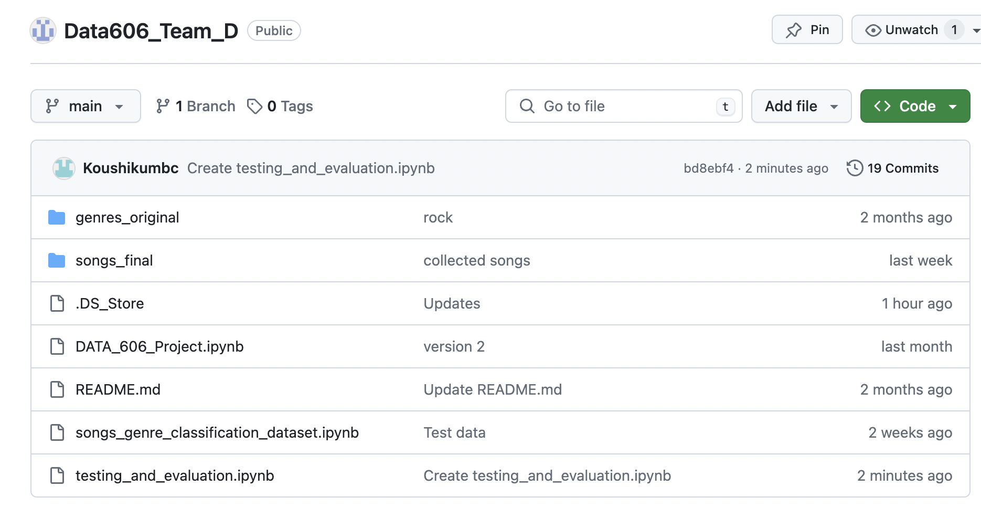
Github Link
https://github.com/Sravanipilla-99/Data606_Team_D.git

Slide 22
References
Tzanetakis, G., & Cook, P. (2002). Musical genre classification of audio signals. IEEE Transactions on Speech and Audio Processing, 10(5), 293-302. https://ieeexplore.ieee.org/document/1021072
Stanford CS229. (2017). Music Genre Classification. https://cs229.stanford.edu/proj2017/final-reports/5244969.pdf
Manwani, A. (2020). Song Genre Classification from Audio Data using ML. Kaggle. https://www.kaggle.com/code/ajaymanwani/song-genre-classification-from-audio-data-using-ml
Udupa, C. (2020). Music Genre Detection using Machine Learning. Kaggle. https://www.kaggle.com/code/chinmayaudupa/music-genre-detection-using-machine-learning
Analytics Vidhya. (2022). Music Genre Classification Project Using Machine Learning Techniques. https://www.analyticsvidhya.com/blog/2022/03/music-genre-classification-project-using-machine-learning-techniques/
Olteanu, A. (n.d.). GTZAN Dataset - Music Genre Classification. Kaggle. https://www.kaggle.com/datasets/andradaolteanu/gtzan-dataset-music-genre-classification/data

